Slide 1
Ensemble Techniques (Bagging and Boosting, Stacking)

Slide 2
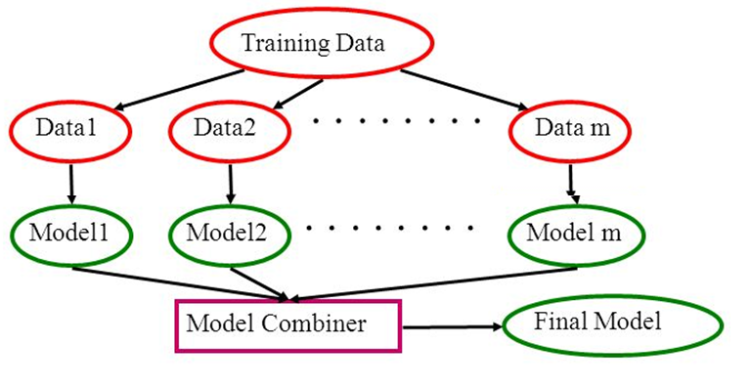
Basic Idea: Ensemble Methods

Slide 3
Why Need Ensemble ??
The main causes of error in learning are due to noise, bias and variance. Ensemble helps to minimize these factors.
These methods are designed to improve the stability and the accuracy of Machine Learning algorithms.
Combinations of multiple classifiers decrease variance, especially in the case of unstable classifiers, and may produce a more reliable classification than a single classifier.

Slide 4
Ensemble Techniques
Bagging
Boosting
Stacking

Slide 5
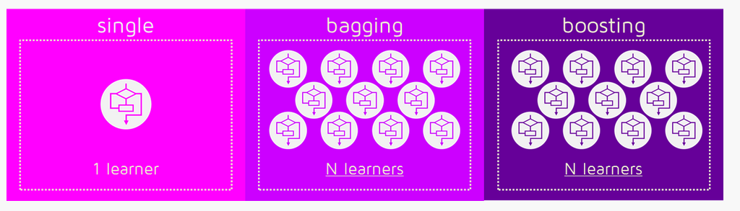
Ensemble Methods

Slide 6
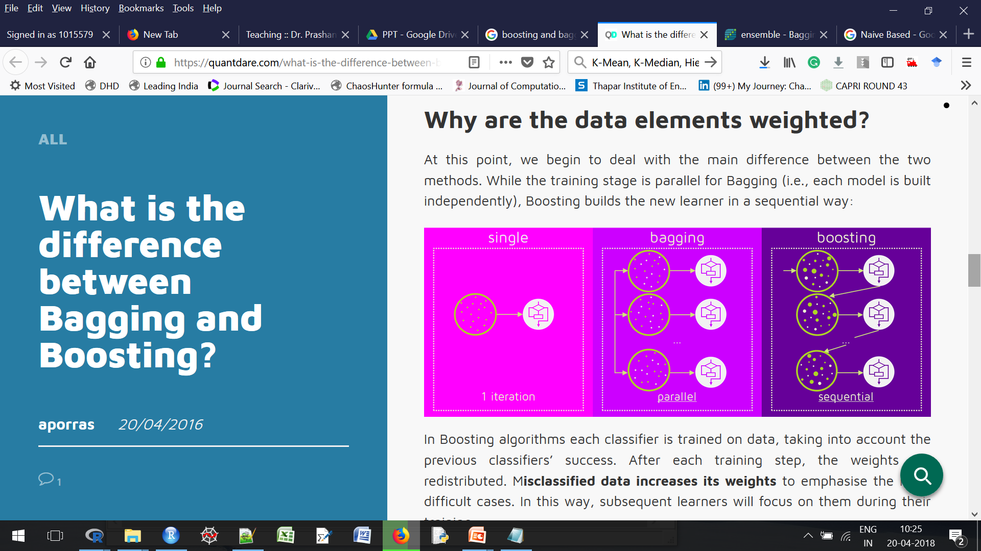
Ensemble Methods
In bagging models build in parallel.
In boosting models build in sequential way.

Slide 7
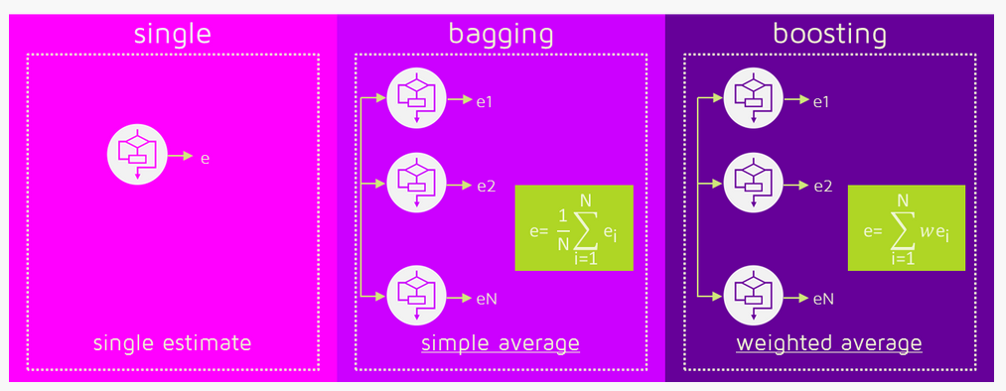
Ensemble Methods

Slide 8
Ensemble Methods - Bagging
Apply Mean/ Wt. Mean / Min/Max
if model is of Regression Type
Apply Voting
if model is of Classification Type
Example

Slide 9
Ensemble Methods - Boosting
Divide the data in two or more parts based on CORRECT Classification or MISSED Classification
Example

Slide 10
Difference b/w Bagging and Boosting
Bagging
parallel ensemble: each model is built independently
aim to decrease variance, not bias
suitable for high variance low bias models (complex models)
an example of a tree based method is random forest, which develop fully grown trees (note that RF modifies the grown procedure to reduce the correlation between trees)
Boosting
sequential ensemble: try to add new models that do well where previous models lack
aim to decrease bias, not variance
suitable for low variance high bias models
an example of a tree based method is gradient boosting
[Ref : Stack Overflow]

Slide 11
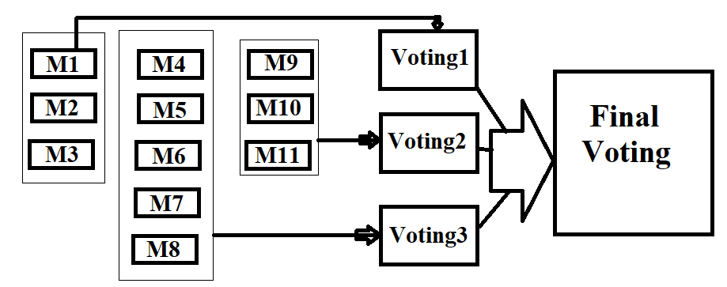
Ensemble Methods - Stacking
Stacking is an advances variant of boosting or bagging or combination of both.

Slide 12
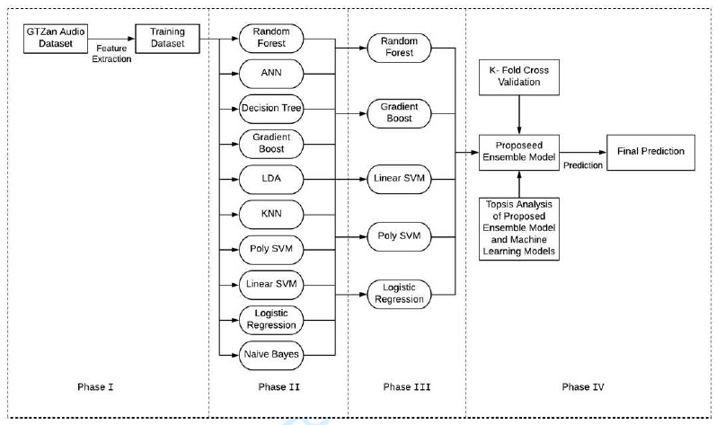
Example1 : Ensemble Methods
Developed by Rudra and Parth, COE, 3rd Year

Slide 13
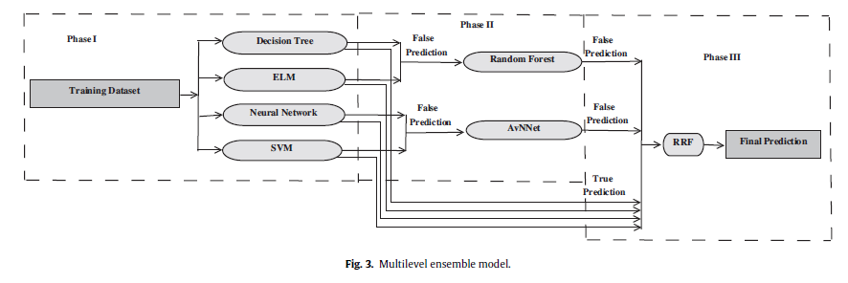
Example2: Ensemble Methods
Developed by Divya Khanna, PhD Scholar

Slide 14
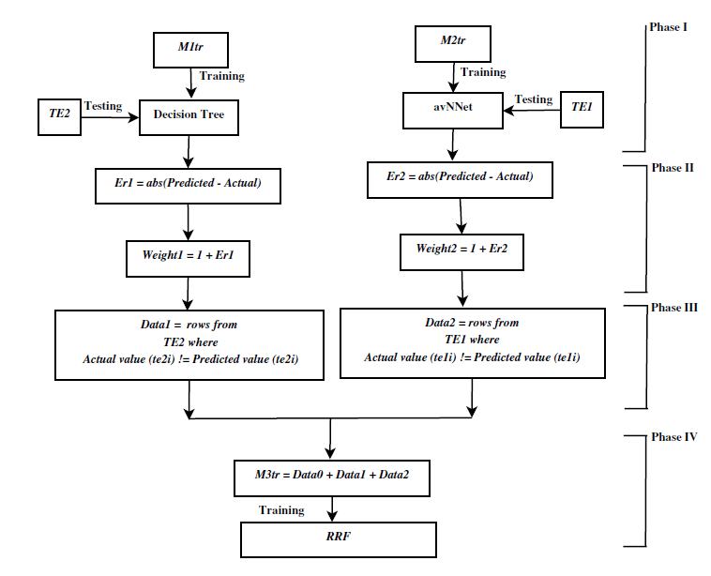
Example3: Ensemble Methods
Developed by Divya Khanna, PhD Scholar

